Slide 1
Introduction to GLMs
Why can’t you be $Normal$?

Slide 2
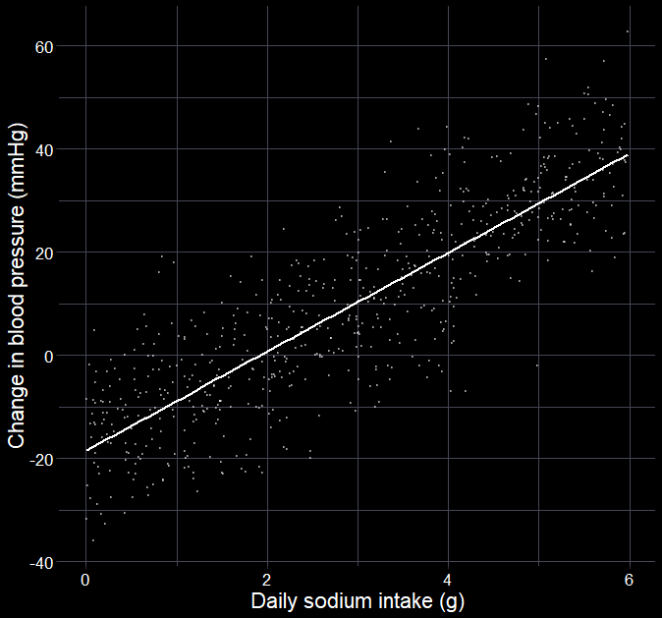
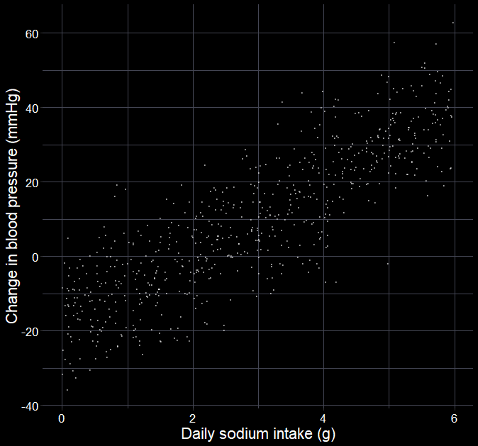

Can we reduce blood pressure?
$$y_{i}∼Normal(μ_{i},σ_{i})$$
$$μ_{i}=β_{0}+β_{1}×{Na}_{i}$$
Where:
$y$ is change in blood pressure
$i$ is the $i^{th}$ patient
$μ$ is the mean
$σ$ is the standard deviation
$β_{0}+β_{1}×Na_{i}$ is the linear predictor, where
$β_{0}$ is the intercept
$β_{1}$ is the slope for sodium

Slide 3
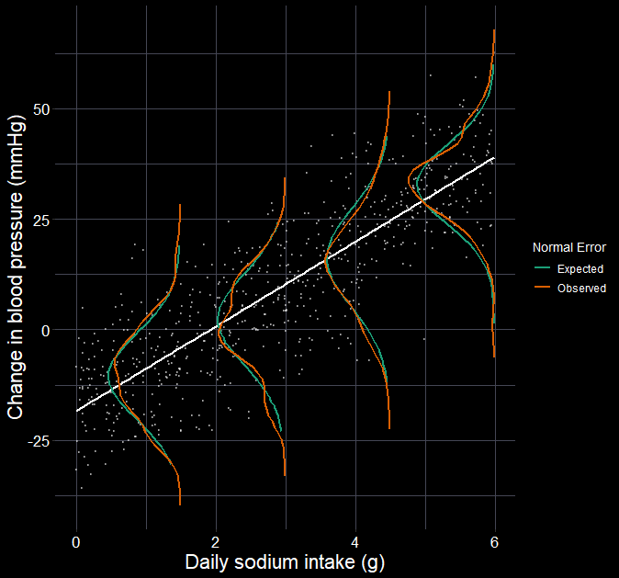




Can we reduce blood pressure?
$$σ=10.1$$
$$y_{i}∼Normal(μ_{i},σ_{i})$$
$$μ_{i}=β_{0}+β_{1}×{Na}_{i}$$
Now estimated as:
$$y_{i}∼Normal(μ_{i},10.1)$$
$$μ_{i}=−18.4+9.6×{Na}_{i}$$
$$β_{1}=9.6$$
$$β_{0}=−18.4$$

Slide 4
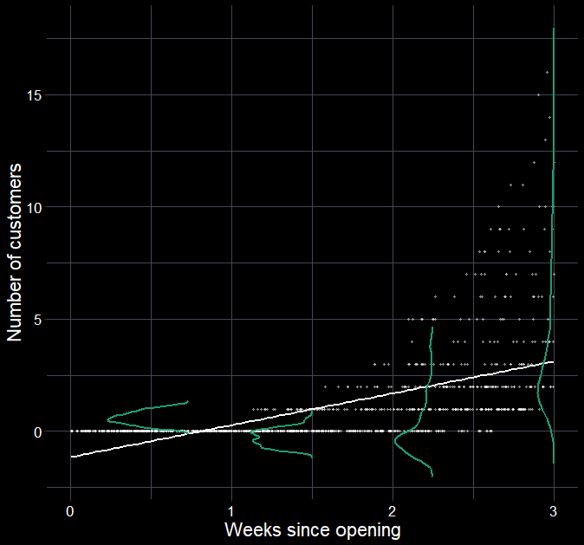
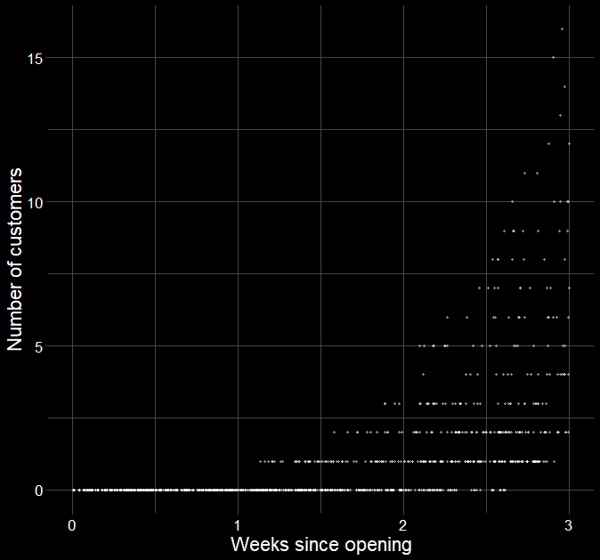
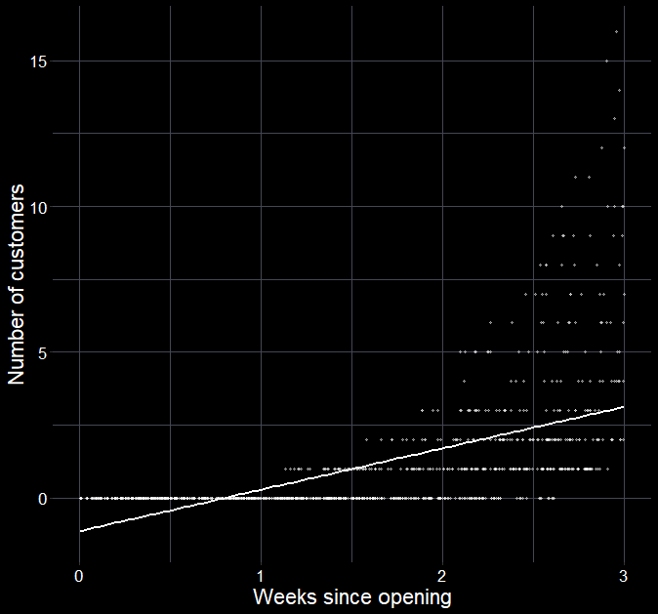

What if our error is not Normal?
What do you notice about the data?
Response must be non-negative
Response is integers
What if we force a linear model?
Can we have negative customers?
Is our randomness best captured with a $Normal$ distribution?

Slide 5
Changing distributions

Slide 6
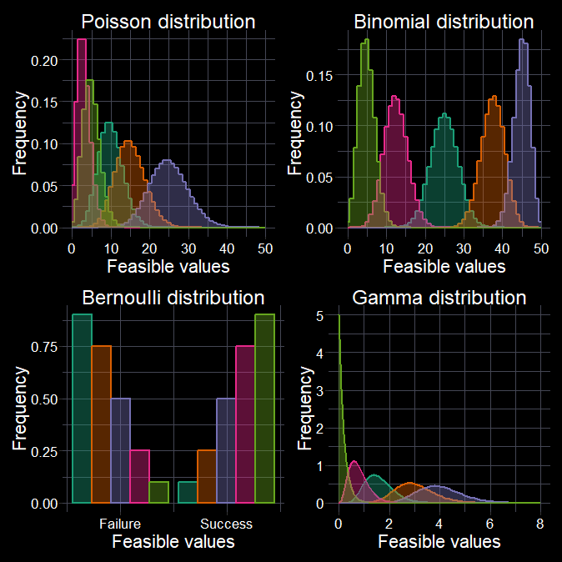
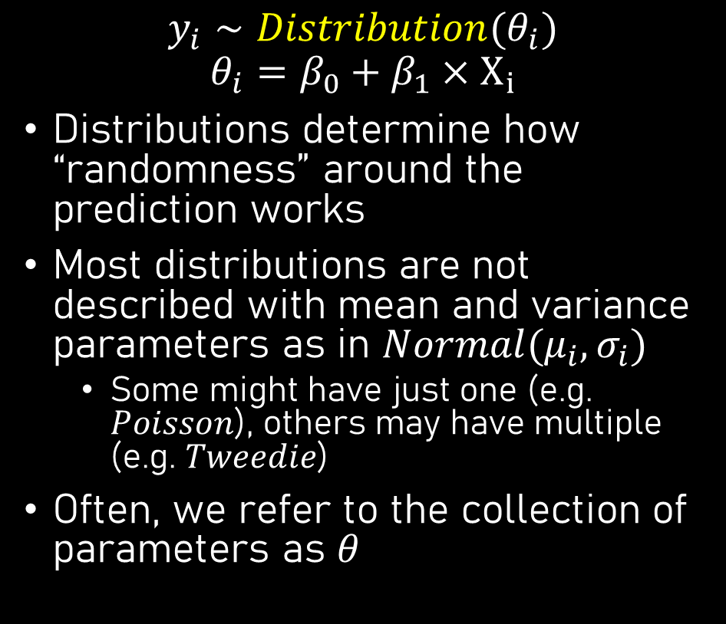
Allowing suitable randomness
$$y_{i}∼Distribution(θ_{i}) \\ θ_{i}=β_{0}+β_{1}×X_{i}$$
Distributions determine how “randomness” around the prediction works
Most distributions are not described with mean and variance parameters as in $Normal(μ_{i}, σ_{i})$
Some might have just one (e.g. $Poisson$), others may have multiple (e.g. $Tweedie$)
Often, we refer to the collection of parameters as $θ$

Slide 7
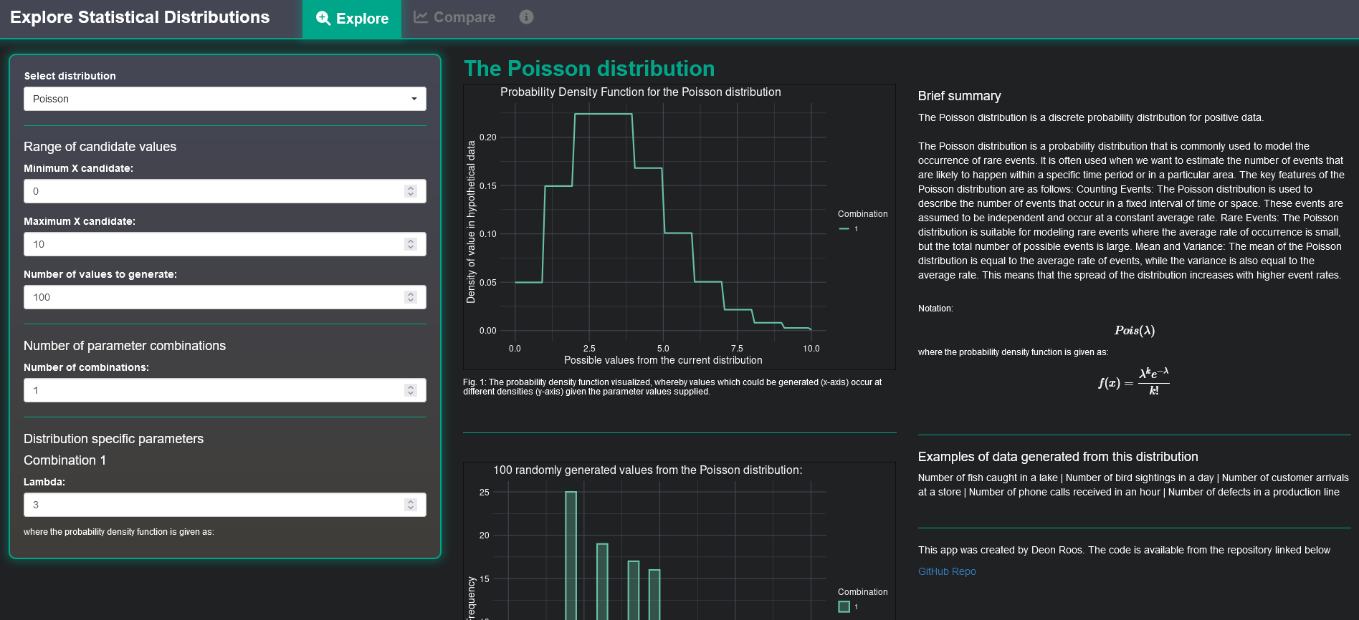
https://deonroos.shinyapps.io/Distributions/

Slide 8
Link functions

Slide 9
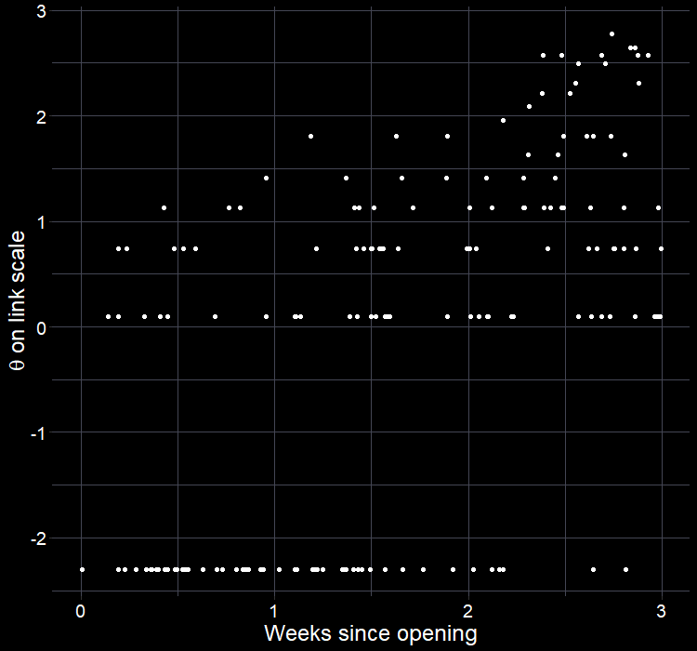
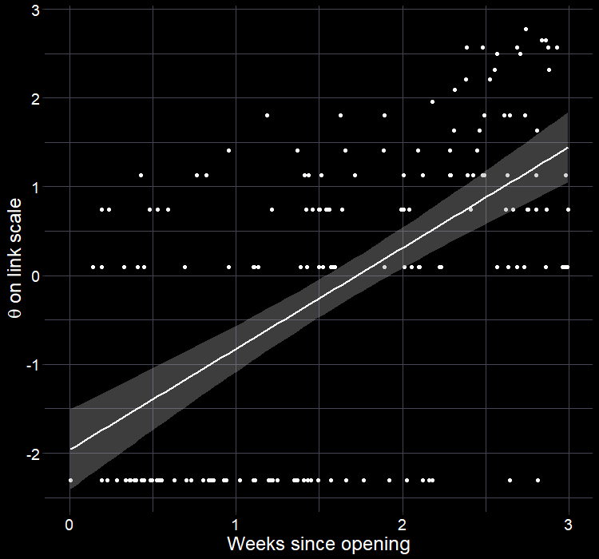
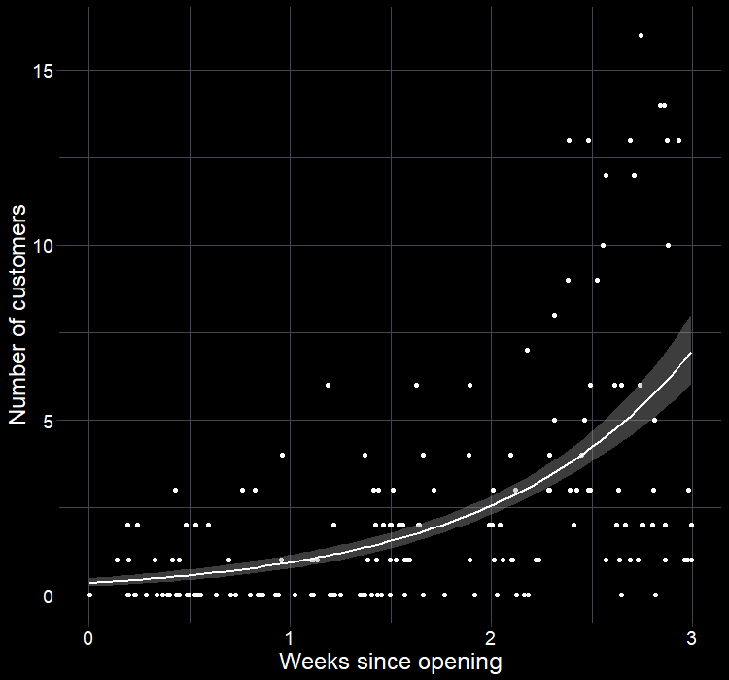
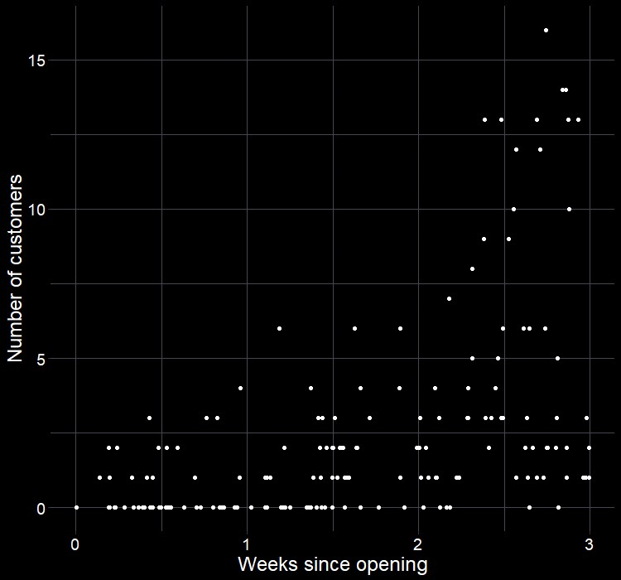
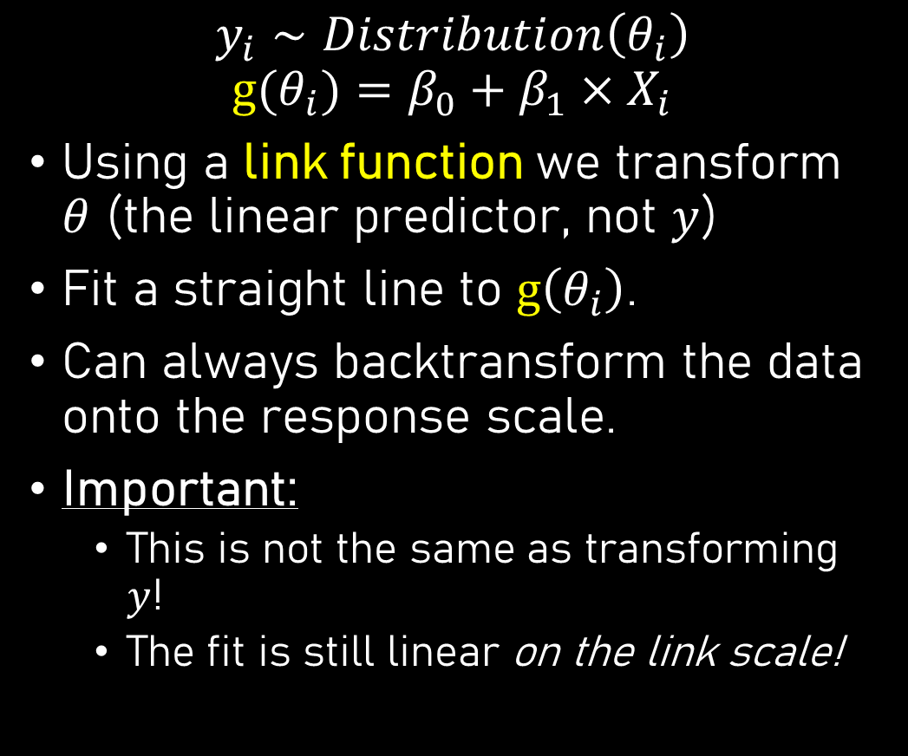
The missing link
$$y_{i}∼Distribution\left(θ_{i}\right) \\ g⁡(θ_{i})=β_{0}+β_{1}×X_{i}$$
Using a link function we transform $θ$ (the linear predictor, not $y$)
Fit a straight line to $g\left(θ_{i}\right)$.
Can always backtransform the data onto the response scale.
Important:
This is not the same as transforming $y$!
The fit is still linear on the link scale!

Slide 10

Why use link function
Link functions mathematically convert the linear predictor ($θ$) such that the values can exist between $−∞$ to $∞$
Generally, leads to a linear trend (great for fitting)
Maintains natural bounds of the data
Is the bridge between our response variable and the linear predictor

Slide 11
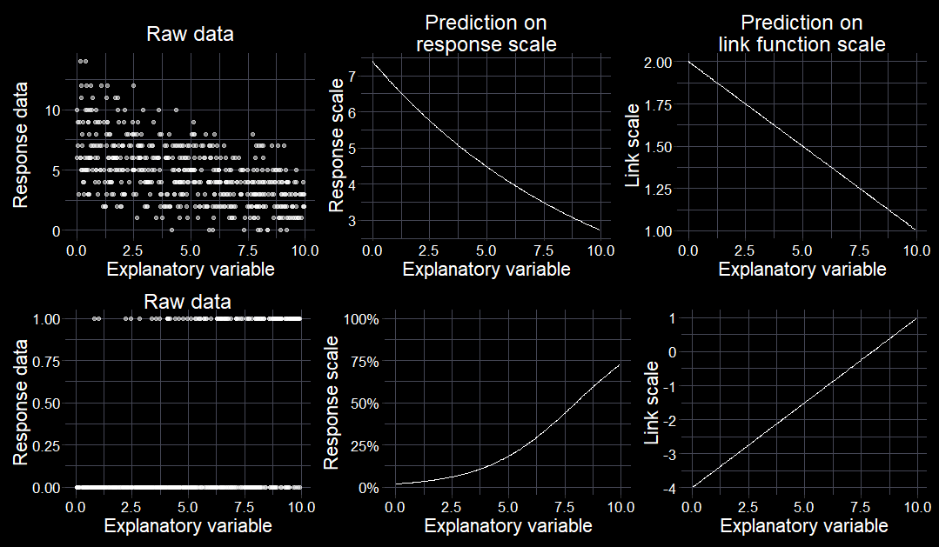
The missing link

Slide 12


GLMs; oversimplified
Know your research question!
Think about your response variable.
Identify which distribution best characterise your randomness.
Think about the process behind the data.
Combine into a model that can answer your question.
Use the default link function or any valid alternative.
Fit the model.
Check your assumption(s).
Answer your question (but beware the Monkey’s Paw).
$$y_{i}∼Normal\left(μ_{i}, σ_{i}\right) \\ μ_{i}=β_{0}+β_{1}×X_{i}$$
$$y_{i}∼Distribution\left(θ_{i}\right) \\ g⁡(θ_{i})=β_{0}+β_{1}×X_{i}$$
glm(y ~ x,
family = Dist(“g”), data = my_data)
lm(y ~ x,
data = my_data)

